Slide 1
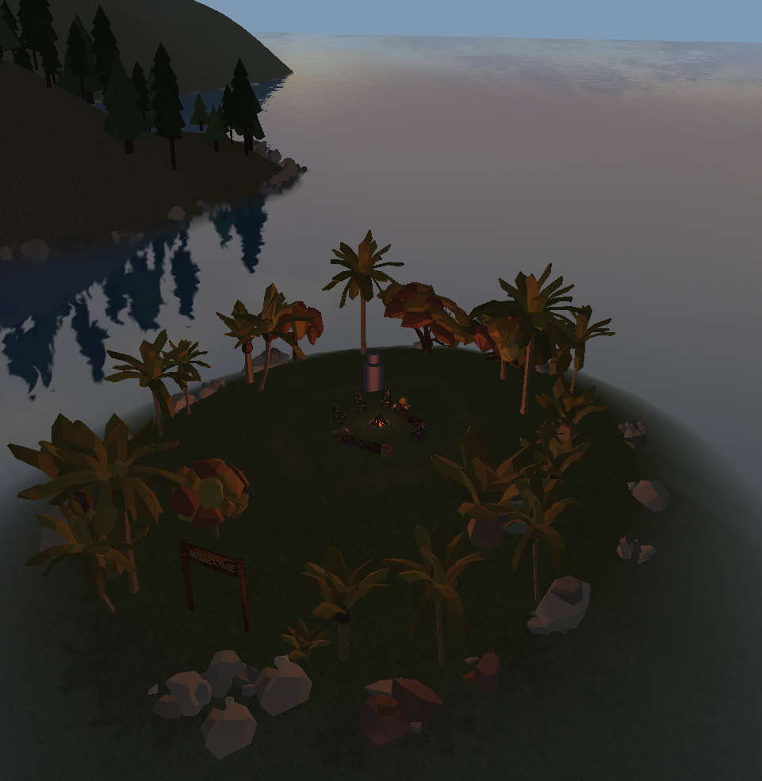
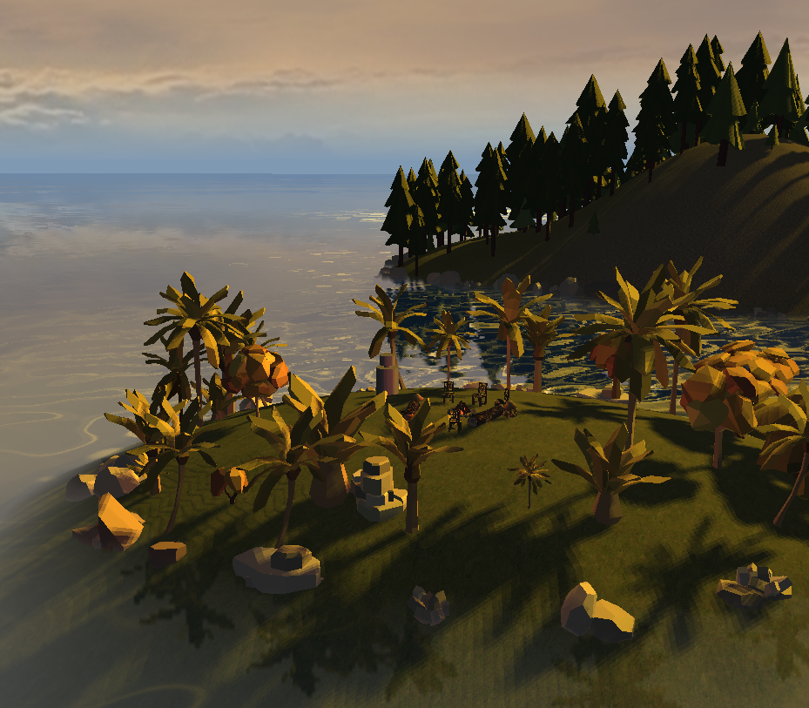
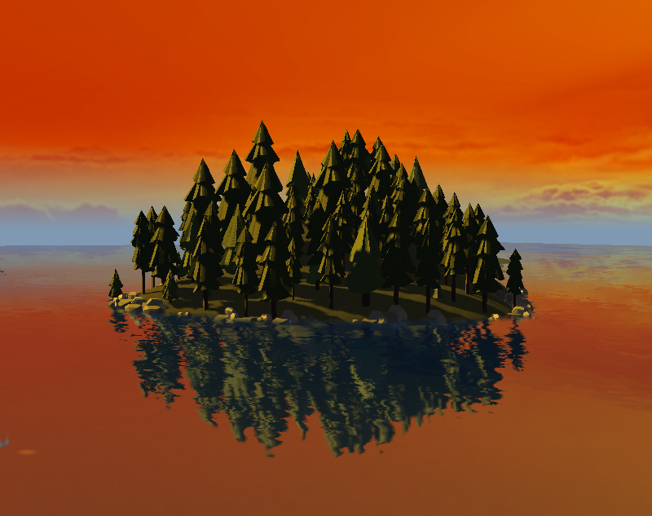
[insert project name]
TSBK07, Eric Ekström

Slide 2
Basics
Goal: To create a beautiful, ”realistic” world.
Java
LWJGL
Why java?
Continued building from lab 4

Slide 3
Basics
Skybox
Fog
Sun and Day/Night cycle
Frustum culling

Slide 4
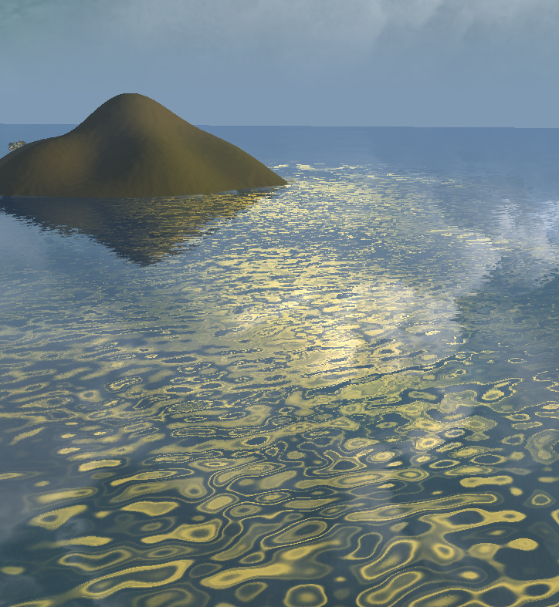
Water!
Framebuffers
Refraction
Reflection
Noise function
Fresnel effect
Sun reflection

Slide 5
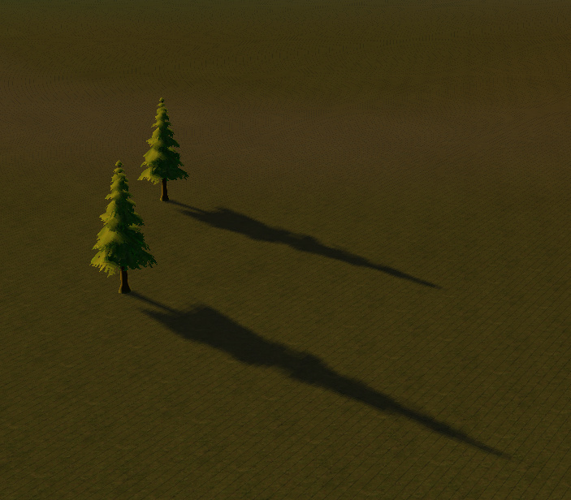
Shadows
Shadow map
Framebuffers again
Render to depth buffer
Problems:
Resolution of the depth map

Slide 6
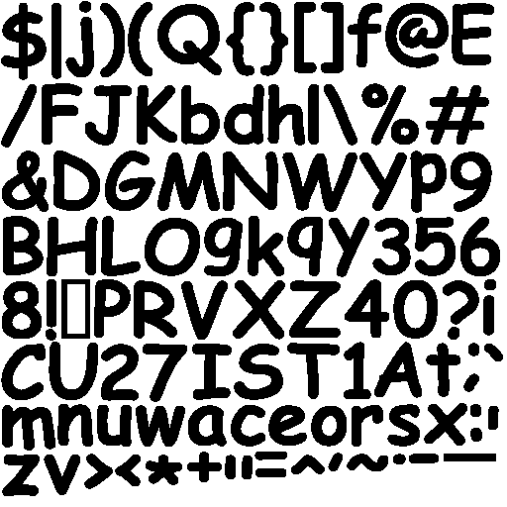
Level Editor
Placing items
Ray casting
State machine
menu
Text rendering
GUI

Slide 7
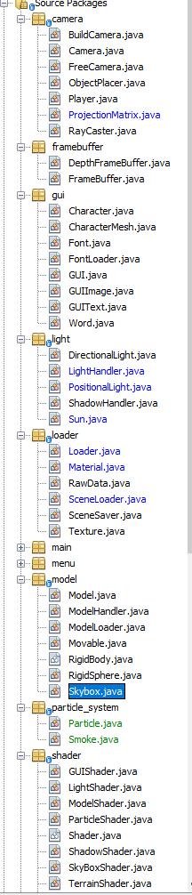
Discussions
Java: smart move or terrible time sink?
Loading objects
Translating code
Code structure
Feature development
Point light shadows
Specular Maps
Lense flares
Procedural terrain
Dealing with transparency
Generated Trees
Clouds

Slide 8
Questions/Demo

